Slide 1
Improving the targeting and therapeutic capabilities of exosomes
Christa C. Huber
Nanoparticles in Brain Therapy
November 8, 2019

Slide 2
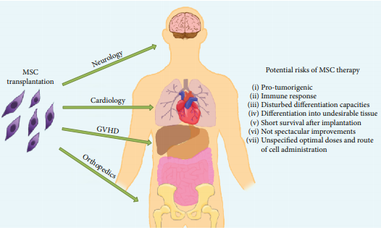
The Problem
Lukomska, B., et al. (2019). Stem Cells Int 2019: 9628536.

Slide 3
Extracellular Vesicles
Gangadaran, P., et al. (2018). Frontiers in Pharmacology 9.

Slide 4
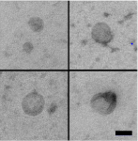
Exosomes
50 – 150 nm in size extracellular vesicles
Released from:
Mesenchymal stem cells
Precursor cells
Sweat
Breast milk
Specifically interact with target cells
Tian, T., et al. (2018). Biomaterials 150: 137-149.

Slide 5
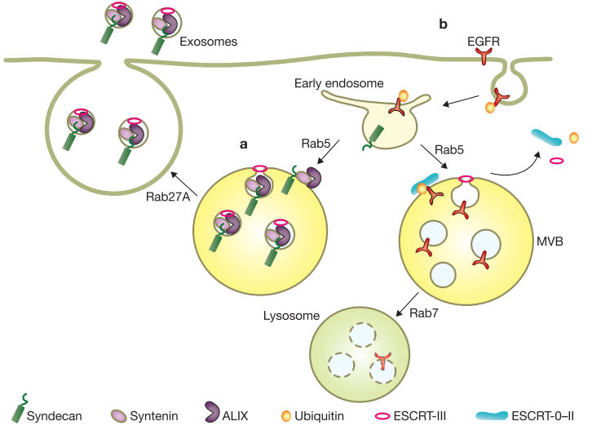
Exosome Biogenesis
Hurley, J. H. and G. Odorizzi (2012). Nat Cell Biol 14(7): 654-655.

Slide 6
Can exosomes be effective at attenuating behavioral and immunological responses in ischemic stroke?

Slide 7
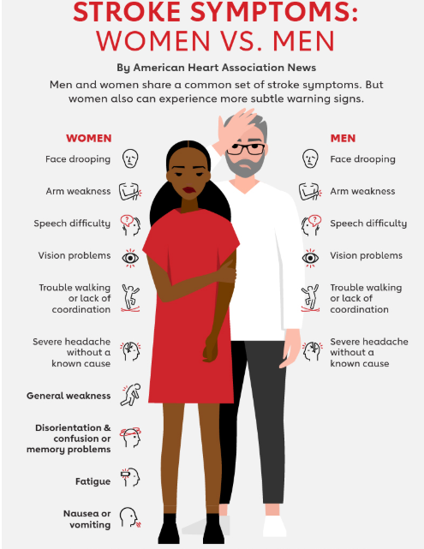
Stroke
Leading cause of long-term adult disability
Fifth leading cause of death in the US
795,000 stroke events/year
Boehme, A. K., et al. (2017). Circ Res 120(3): 472-495.

Slide 8
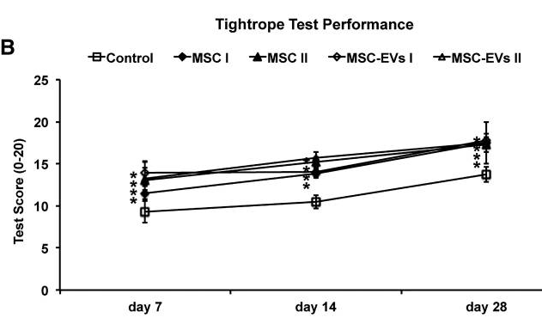
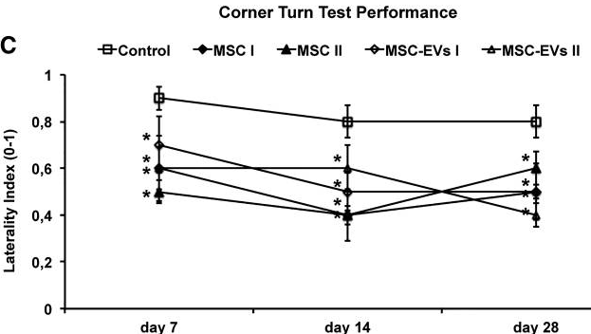
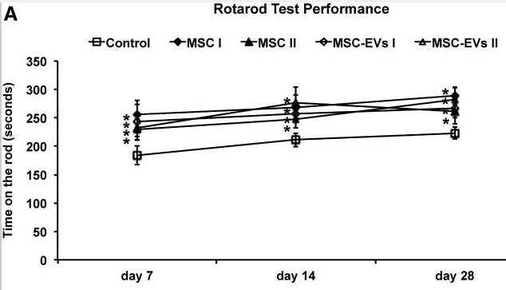
MSC-EVs alleviate motor impairment
Doeppner, T. R., et al. (2015). Stem Cells Transl Med 4(10): 1131-1143.

Slide 9
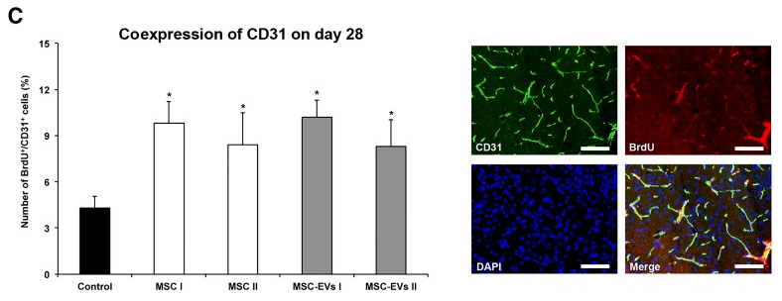
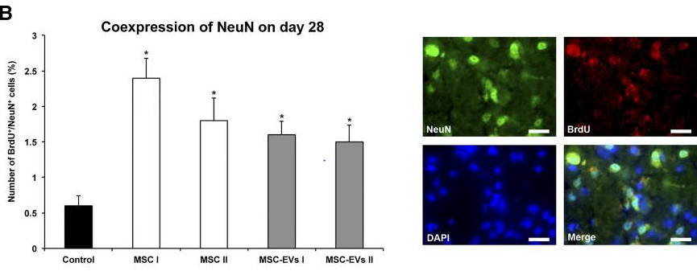
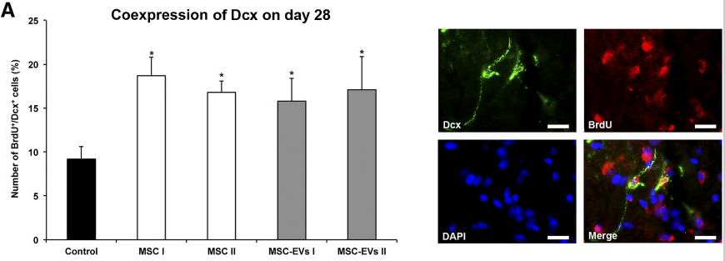
MSC-Evs promote angioneurogenesis
Doeppner, T. R., et al. (2015). Stem Cells Transl Med 4(10): 1131-1143.
Notes:
Figure 4A

Slide 10
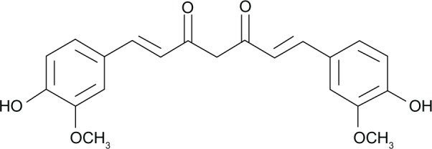
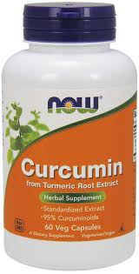
Can curcumin pretreatment improve neurological function?
Curcumin:
Cyclooxygenase inhibitor
Anti-inflammatory
Anti-carcinogenic
Anti-thrombotic
Samini, F., et al. (2013). Pharmacol Biochem Behav 110: 238-244.

Slide 11
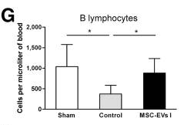
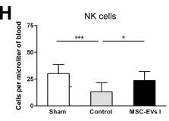
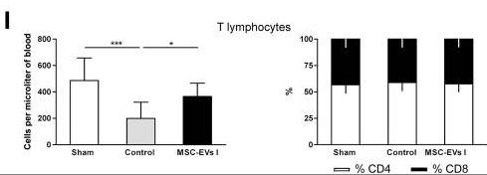
MSC-EVs decreased lymphopenia
Doeppner, T. R., et al. (2015). Stem Cells Transl Med 4(10): 1131-1143.
Notes:
Figure 6

Slide 12
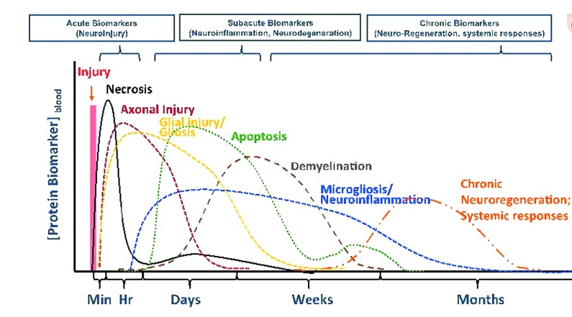
Traumatic Brain Injury
Bramlett, H. M., et al. (2015). Journal of neurotrauma, 32(23), 1834-1848.

Slide 13
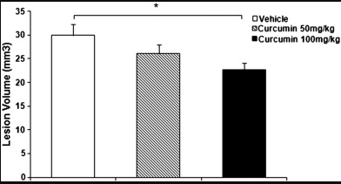
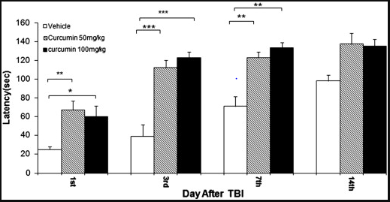
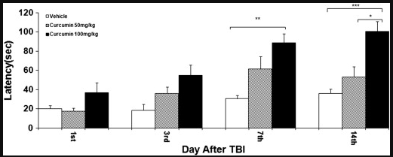
Protective effects of curcumin
Lesion Volume
Inclined-Plane Test
Rotarod Test
Samini, F., et al. (2013). Pharmacol Biochem Behav 110: 238-244.

Slide 14
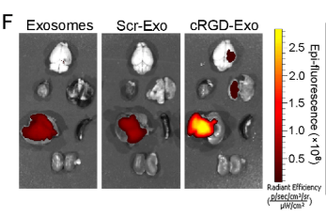
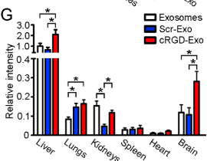
Unmodified exosomes accumulate in a variety of organs
Tian, T., et al. (2018). Biomaterials 150: 137-149.

Slide 15
Hypotheses
Curcumin loaded exosomes will relieve the inflammatory response following ischemic stroke.
Conjugation of a peptide to exosomes will target exosomes to the brain.

Slide 16
Conjugation of functional ligands
Cyclo(Arg-Gly-Asp-D-Tyr-Lys) peptide
High affinity to integrin α_{v}β₃
Expressed on reactive endothelial cells following ischemia
Tian, T., et al. (2018). Biomaterials 150: 137-149.

Slide 17
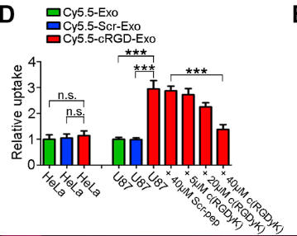
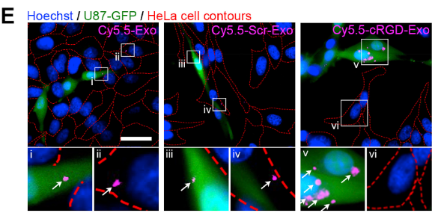
Cells expressing integrin α_{v}β₃ uptake of cRGD-Exo
Tian, T., et al. (2018). Biomaterials 150: 137-149.

Slide 18
cRGD-Exo uptake in the brain
Tian, T., et al. (2018). Biomaterials 150: 137-149.

Slide 19
Modified exosomes accumulate in the brain
Tian, T., et al. (2018). Biomaterials 150: 137-149.

Slide 20
Modified exosomes accumulate in the brain
Tian, T., et al. (2018). Biomaterials 150: 137-149.

Slide 21
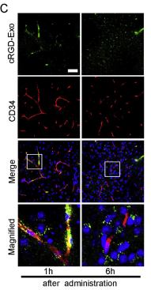
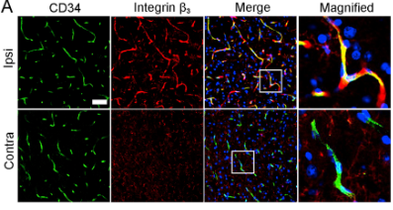
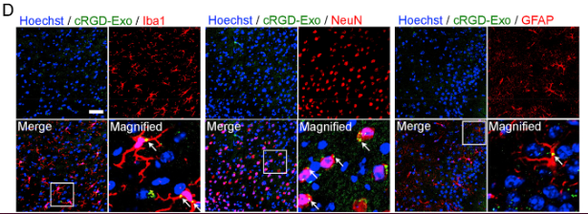
Cellular localization of cRGD-Exos
12 hours after reperfusion
Tian, T., et al. (2018). Biomaterials 150: 137-149.

Slide 22
Incorporation of curcumin enhanced delivery efficiency
Tian, T., et al. (2018). Biomaterials 150: 137-149.

Slide 23
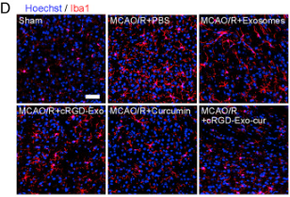
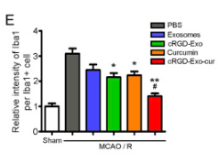
cRGD-Exo-cur inhibits the inflammatory response
Tian, T., et al. (2018). Biomaterials 150: 137-149.

Slide 24
Take-Home Messages
Pretreatment with curcumin attenuated behavioral changes following TBI.
Chemically modifying exosomes are effective at targeting specific organs of the body.
Suppresses inflammation
cRGD-Exo accumulate in the lesion region of the ischemic brain.
MSC-derived exosomes are a better therapeutic than MSCs due to malignant transformation being extremely unlikely.

Slide 25
What is next?
Determine if there are any changes in characteristics of modified exosomes.
Do they still exhibit low immunogenicity?
Examine if modified exosomes attenuate behavioral symptoms associated with stroke better than unmodified exosomes.
Can this modification technique be applicable to any other disorders?

